Slide 1

Session Name:
Frequency Distributions and Tabulation
Delivered By:
Vikash Singh

Slide 2

Learning Objectives
By the end of this session, you will be able to:
Understand percentage, cumulative, and frequency density concepts
Understand bivariate and multivariate frequency distributions
Explain tabulation objectives and its importance
Learn different types and methods of tabulation

Slide 3




DY Patil Learner App
For Android Users:
Open the Google Play Store on your device and search for "DYP Learner App".
Tap the app from the search results and select Install.
Once installed, tap Open or locate the app on your home screen.
Log in using your LMS credentials.
👉 Download Now: Google Play Store Link
For iOS Users
Open the App Store on your device and search for "DYP Learner App".
Tap the app from the results and select Get to install.
Once installed, tap Open or find the app on your home screen.
Log in using your LMS credentials (registered email ID and LMS password).
👉 Download Now: App Store Link

Slide 4
Recap: Frequency Distribution?
Definition: Frequency distribution is a structured representation of data that shows how often each value or group of values occurs in a dataset.
Discrete Frequency Distribution:
For countable values (e.g., number of defects)
Continuous Frequency Distribution:
For measurable continuous values (e.g., height, weight, temperature)

Slide 5






Relative (Percentage) Frequency Distribution
Definition:
The proportion (or percentages) of occurrences of each class relative to total observations.
Formula:

Slide 6
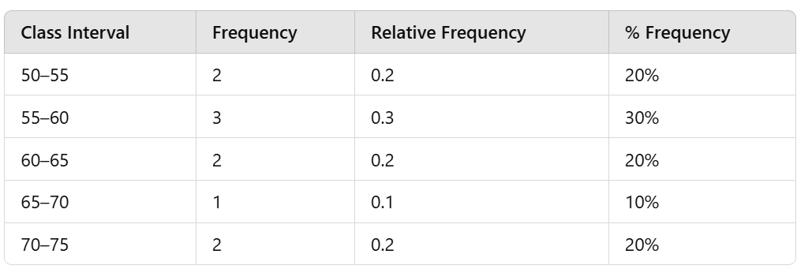









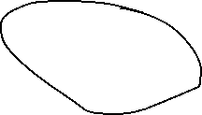






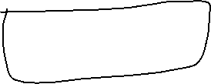



Relative (Percentage) Frequency Distribution Example

Slide 7
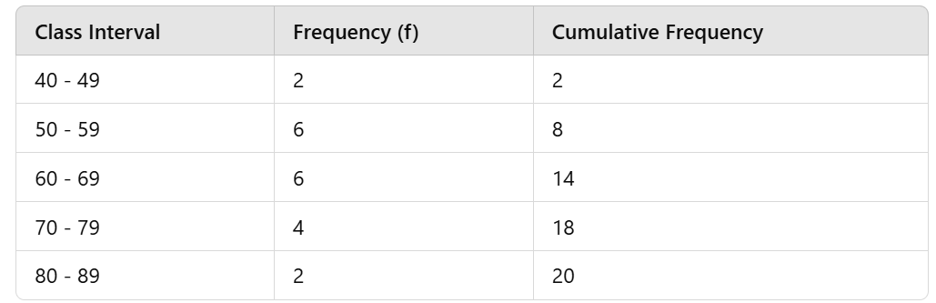











Cumulative Frequency Distribution
Definition: The running total of frequencies as you move down the table.
CF = frequency of that class + cumulative frequency of preceding class

Slide 8

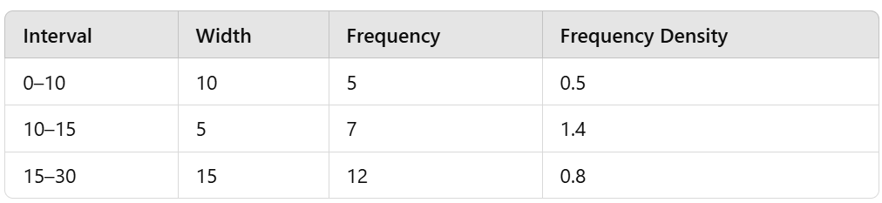




Frequency Density
Useful when classes are unequal in width.

Slide 9
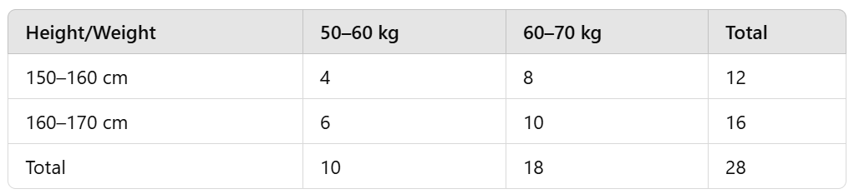
Bivariate and Multivariate Frequency Distributions
Bivariate: Two variables (e.g., height vs. weight). Example: Analyzing height vs. weight of individuals.
Multivariate: More than two variables (height, weight, age). Example: Studying height, weight, and blood pressure together.

Slide 10
Quiz
Q1. Relative frequency formula is:
A) Frequency × 100
B) Frequency ÷ Total frequency
C) Frequency ÷ Class width
D) Class width ÷ Frequency
Q2: A bivariate frequency distribution involves: A) 1 Variable B) 2 Variables C) 3 Variables

Slide 11
Quiz
Q1. Relative frequency formula is:
A) Frequency × 100
B) Frequency ÷ Total frequency ✔️
C) Frequency ÷ Class width
D) Class width ÷ Frequency
Q2: A bivariate frequency distribution involves: A) 1 Variable B) 2 Variables ✅ C) 3 Variables

Slide 12
Objectives of Tabulation
Condense data clearly
Simplify comparisons
Highlight significant points
Facilitate statistical analysis
Enhance readability

Slide 13
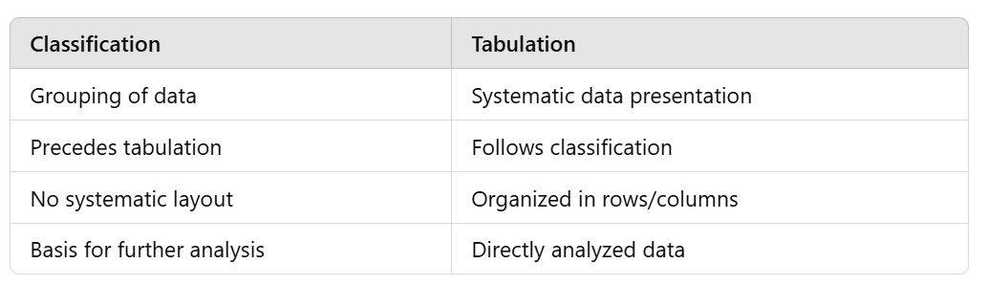



Classification vs. Tabulation
Classification: Organizes raw data into categories.
Tabulation: Presents classified data in a structured table format.

Slide 14
Main Parts of a Table
Title
Table Number
Column and Row Headings (Captions/ Stubs)
Body
Footnotes/ Source

Slide 15
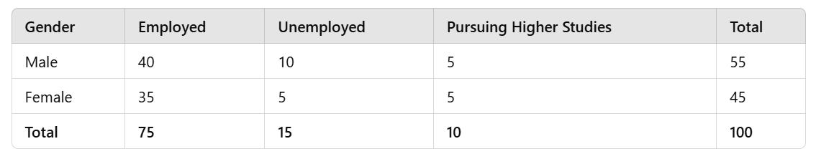








Sample Table
Title: Employment Status of MBA Graduates by Gender – Batch of 2023
Source: DYP Website

Slide 16
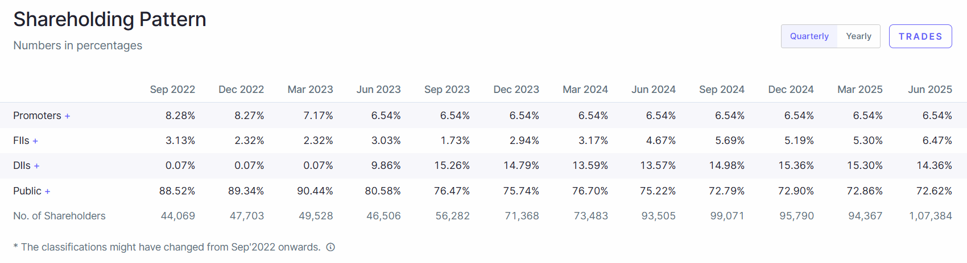
Sep 2022 | 3.13%
Sep 2023 | 1.73%
June 2025 | 6.47%

Slide 17
Quiz
Q3: Difference between Classification and Tabulation is:
A) Order of processing data
B) Both are identical
C) Only visual difference
D) Tabulation precedes classification
Q4: What is not a part of a table?
A) Title
B) Caption
C) Range
D) Footnote

Slide 18







Quiz
Q3: Difference between Classification and Tabulation is:
A) Order of processing data ✔️
B) Both are identical
C) Only visual difference
D) Tabulation precedes classification
Q4: What is not a part of a table?
A) Title
B) Caption
C) Range ✔️
D) Footnote

Slide 19
Types of Table
Simple Table
Complex Table
General Purpose Table
Special Purpose Table

Slide 20
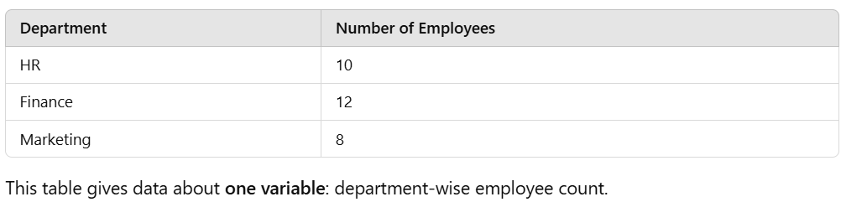
Simple Table (One-Way Table)
A simple table presents information about only one characteristic or variable. It is the most basic form of tabulation.

Slide 21
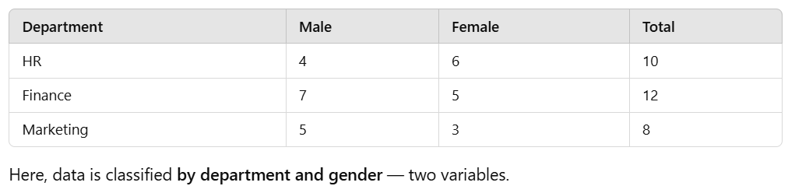
Complex Table (Two-Way, Three-Way, or More)
A complex table provides information about two or more interrelated variables. It can be two-way, three-way, or manifold depending on the number of characteristics shown.

Slide 22
General Purpose Table
A general purpose table (also called a reference table) contains detailed information and is used when users might want to analyze the data in many ways.
It doesn’t focus on a single conclusion.
Example:
A census table showing population data by age, gender, education, employment status, etc. for each district — meant for broad reference and deep analysis.
It’s not designed to emphasize one specific insight, but to be a comprehensive resource.

Slide 23
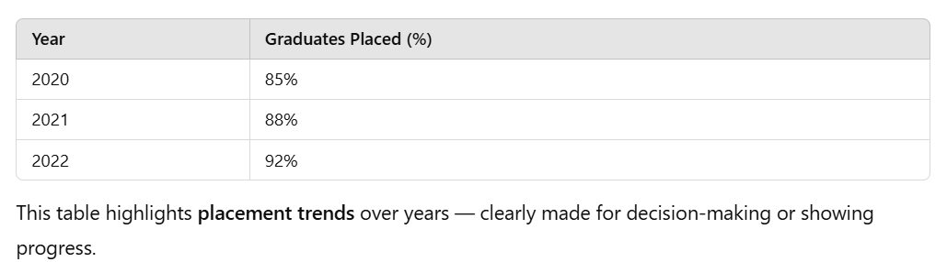
Special Purpose Table
A special purpose table (also called a summary table) is designed to highlight a specific insight or finding.
It's tailored to the purpose of a particular report, presentation, or decision.

Slide 24
Quiz - Identify the Table Type (Visual Thinking)
Q1: You are analyzing student results across subject, class, and gender.
What kind of table would you use?
Q2: A table shows number of passengers travelling by mode of transport (car/bus/train).
Q3. Data of patients classified by gender, age group, and illness type.
Q4. A census bureau wants to analyze data based on gender, region, age group, and income slab.

Slide 25
Quiz - Identify the Table Type (Visual Thinking)
Q1: You are analyzing student results across subject, class, and gender.
What kind of table would you use? Answer: Three-way table
Q2: A table shows number of passengers travelling by mode of transport (car/bus/train). Answer: One-way table
Q3. Data of patients classified by gender, age group, and illness type. Answer: Three-way table
Q4. A census bureau wants to analyze data based on gender, region, age group, and income slab. Answer: Manifold table

Slide 26
Session Summary
In this session, we have discussed about:
Understand percentage, cumulative, and frequency density concepts
Understand bivariate and multivariate frequency distributions
Explain tabulation objectives and its importance
Learn different types and methods of tabulation

Slide 27

Happy Learning

